Slide 1


PROTECT AMERICA | DEPENDABLE SECURITY FOR EVERY HOME
The Protect America Opportunity

Slide 2
Welcome to Protect America
Expectations for Success – Executive Engagement
Commitment, Training , Sale, Install
Training Overview
The Dashboard
Product & Pricing
Positioning
The Competition
Discovery & The Pitch
Customized Sessions
Executive Resource Review – Agent Tool Box
Training
Reporting
Marketing
30 Day Business Plan
Training
Personnel
Activity Model
Marketing
Revenue Expectations

Slide 3
Executive Engagement
We have selected you as our Partner
We have invested in you as our Partner
We are committed to your success
We do not succeed unless you succeed
Committed Executives are successful
Without commitment from Executives, we will not achieve your goals
We are asking for your commitment to the goals we’ve shared and your best foot forward

Slide 4
Executive Execution
Examples:
Compensation to Staff
Customized Collateral
Events
TIA – Truth in Activity
Revenue Goals

Slide 5
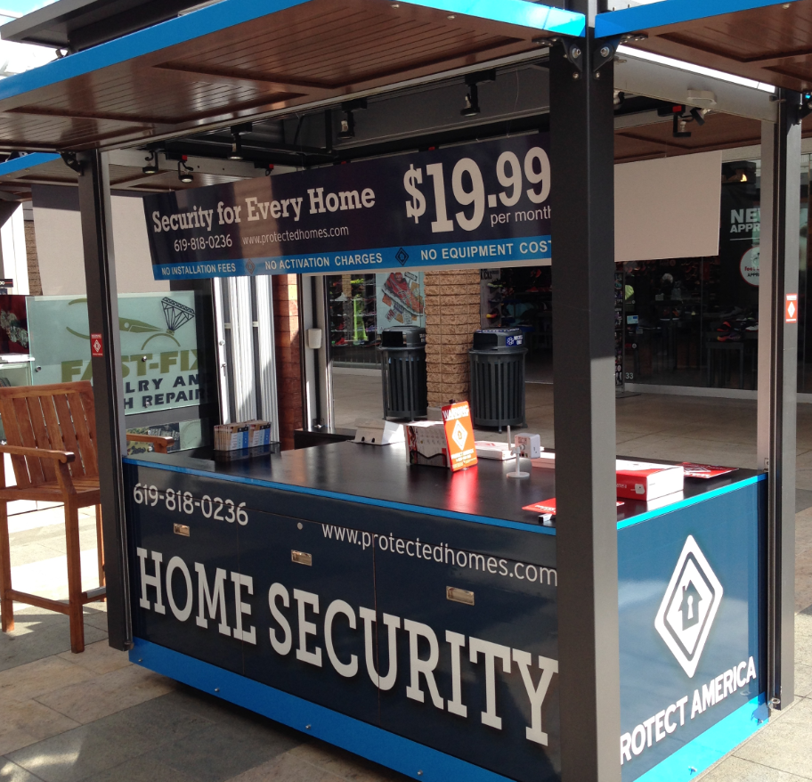
Training Fundamentals: LIVE Modules – 12p CST
Monday – Process
The Dashboard, Order Entry, Proprietary Point Swop, Pricing Matrix
Tuesday & Thursday – Product & Pricing – PA Fundamentals
Product & Pricing – Protect America Overview, Packages, Products, Attachments
Wednesday – Positioning – Protect Your Paycheck
Positioning – The Structure of the Sale, Top Down Selling, FABs, Closing
Friday – The Competition – Keeping your Enemies Close
Competition, Telco, Master Dealers, Corporate Competitors
Other Modules:
Discovery – The Deep Dive
Selling Best Practices – Retail, D2D, Events, B2B, Call Center
Marketing, Digital, Follow-up & Resources
Customized Modules:
Team sessions, niche focus, EX: PPC, SEO, Call Center, Kiosk, Events etc.

Slide 6

PA PROFIT PUNCH - $50 RMR AVERAGE
Type of Monitoring
85% Cellular Attachment
$12 RMR
Type of Package – Premium Package Loading: 75%
Platinum – 25%
Gold – 20%
Silver – 30%
PROFIT PUNCH
GPS - $10 NET RMR
CAMERAS (comes with POS Expectations)
$7 NET RMR
Smoke - $2 NET RMR
Carbon - $2 NET Carbon

Slide 7
Revenue & Payment terms
Executive Pay Period – Every Friday
Install Mon-Sun (11p)
Paid out following Friday
Paid every Friday: ACH with excel file breakdown emailed to you
From Sale to Shipment (Dashboard)
Agreement must be SIGNED by Customer before shipped out
If not signed in 24hrs, Agreement & Promotions expire
Drop sale completion rate 50%
From Shipment to Installation (Reports)
Ave 2.56 days from Signature to Delivery (ground shipping)
PA calls customer to assist in Delivery
Your Follow-up Calls

Slide 8
Protect America Dashboard & Reports
Installation Follow-up (Reports)
Next Day Call – Shipping Delivery/Tracking Info, Thank-You
5 Day Call – Satisfaction Call
2 Week Call – Satisfaction, Thank-You, Referral
2 Month Call - Satisfaction, Thank-You, Referral
5 Month Call – Referral
Track Compensation
Installation Completion

Slide 9
The SCIENCE OF ACTIVTY
D2D
Cold Knocking
New Movers
Crime Spotters
MDUs
New Developments
Retail
Presentations
In Home Appointments
Credits Ran
Field
Events
B2B
Take One Stands
Referral Partnerships – real-estate, movers

Slide 10
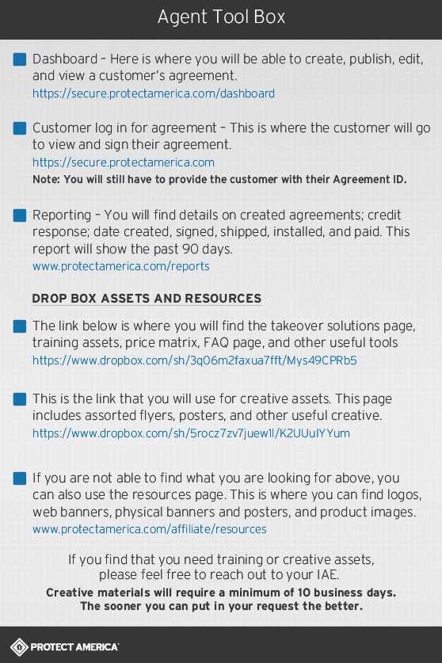
Training ToolBox
Training Resources
PowerPoint Modules
Recorded Sessions
All other useful documents:
Matrix
FAQ
Price Matrix
Objections
Sales Structure
Discovery Questions
Self-Install Pitch

Slide 11
Marketing Resources
Field Kits
Events Supplies
Creative Files
Website Support
www.protectmonitoring.com
www.getsecuritynj.com
www.hhprotect.com
www.protectedhomes.com

Slide 12
The Opportunity IS NOW
Industry is growing at $5Billion a year
Time Warner merged with Comcast
ATT built $65million monitoring facility
If customer doesn’t choose YOU for security, they’ll buy from another in 1 year
LET’S DO THIS TOGETHER!!!

Slide 13
The Opportunity IS NOW
THANK YOU!

